Slide 1
MISY4486
Term Project
Notes:
Hello everyone
I’m ahmet hakan
today I will tell you about my project
The region I choose in my project is Rize Pazar, my hometown.
Okey let’s start

Slide 2
Contents
1- Purpose of the Study
2- Region of Study
3- Legend
4- Analysis
5- Result Image
Notes:
The contents of the project are;

Slide 3
The Purpose of the Study
The aim of the study is to investigate whether the location of the markets in Rize Pazar is according to the population.
It is a study in which the question of whether the population per building in the Rize market is higher than the inner parts of the coastal area.
Notes:
The project has two purposes.
1.Den sonra
In other words, does the dense population affect the number of markets in that region?
2.Den sonra
So is there a dense population on the coast?

Slide 4
Study Area
Rize Pazar İlçe Merkezi
487 Total Number of Objects
Number of ways: 65
Neighborhood limit: 1
Buffer zone: 12
Number of buildings: 397
Number of intersections: 134
Number of markets: 12
Notes:
The areas of work in the project are:
four hundred eighty seven Total
Ways Sixty five
One
Zone twelve
Buildings three hundred ninety seven
İntersection one hundred thirty four

Slide 5
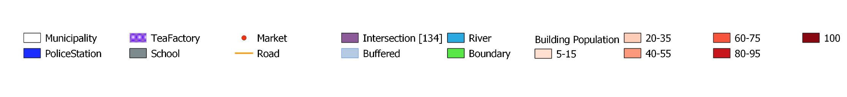
Legend
Notes:
The legend of the map is as you can see in the image.

Slide 6
Attribute Analysis
Analysis 1:
Does the population rate affect the location of the markets?
First of all, the borders of the Rize Market center and all the settlements on the map with the polygon layer; roads and rivers created with line layer.
All buildings are assigned attributes (building and population).
An area of 100 meters in diameter was created around the markets using buffer.
Buildings and population that intersect with the created buffer zone were determined.
Analysis results:
As a result of the buffer and intersection created, it was determined that the building density affects the position of the markets, but not the population.
Notes:
my question is
Here are my steps in order
hundert

Slide 7
Spitial Analysis
Analysis 2:
Is there a difference between the coastal population and the inland population?
Is the population ratio of the buildings in the coastal part more than 50?
First of all, the borders of the Rize Market center and all the settlements on the map with the polygon layer; roads and rivers created with line layer.
All buildings are assigned attributes (building and population).
The buildings were categorized according to the population and the population ratio was indicated with different colors from high to low (dark color is intense, light color is not intense).
Buildings with a population rate of over 50 were questioned.
When the buildings with a population ratio of more than 50 were questioned,
Analysis results:
it was determined that the population in the coastal area is denser than in the interior, The majority of the population preferred to live near the center and the coastal area.
Notes:
I have two questions here
first question is
Second question is
Here are my steps in order

Slide 8
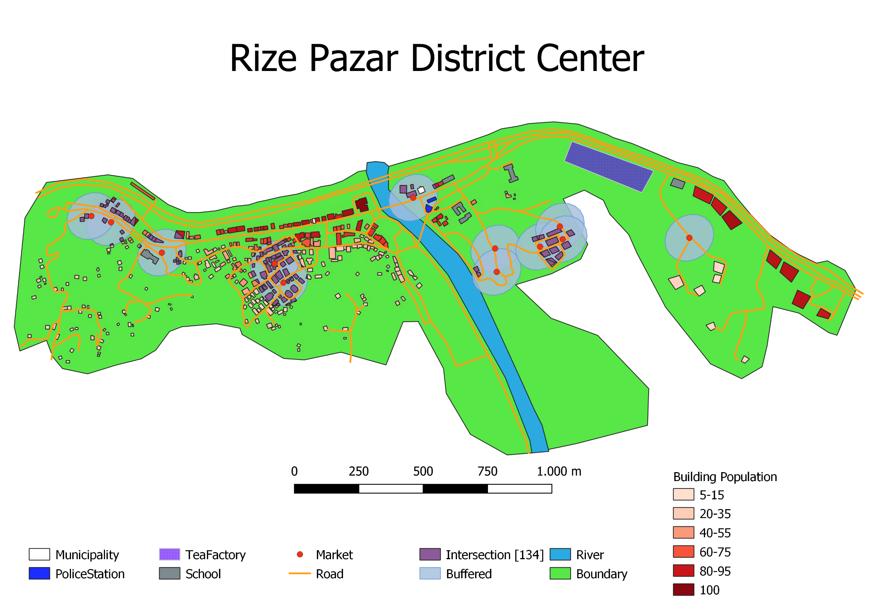
Notes:
you can see buildings sorted by color density
You can see that the number of people per building is higher in the coastal area.
As you come inland, the population density decreases.
We can see that the population in the buildings in the coastal zone is more than 50 people.
red dots is markets
this is the color of the buffer
the color of the buffers is turquoise and the buildings it intersects are purple
so when we look at it, we can understand that the markets are not according to the population.
There are only 2 markets in the densely populated area.
but although the population is not dense, there are 5 markets in this region
We can understand that the sales potential of the markets in this region is not according to the population.
thanks for listening

